Slide 1
Last Week
Schematic for QFN Adapter
Layout
nRF development environment setup
Ran a sample problem
Start looking into SPI communication

Slide 2
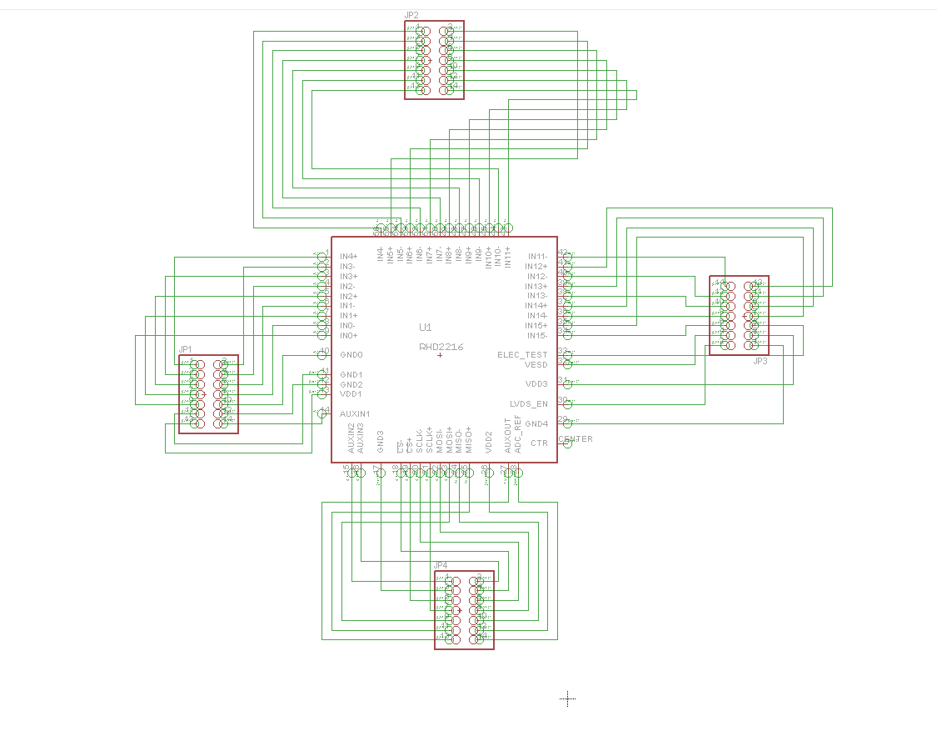

Slide 3
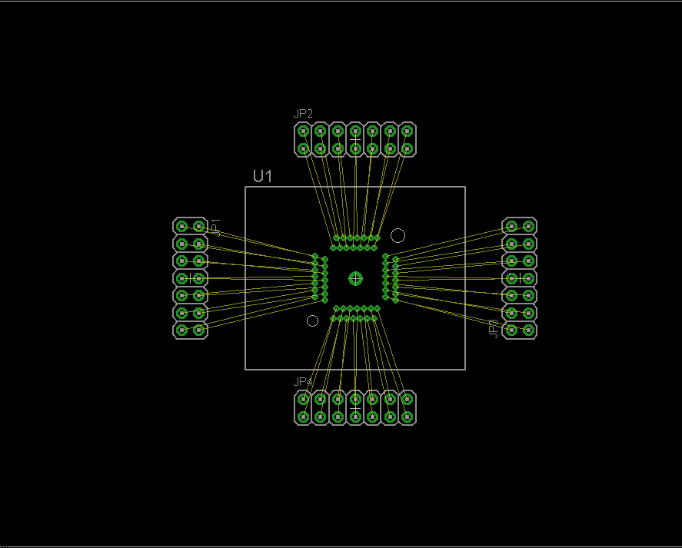

Slide 4
Next Week
Continue nRF development
Look into RF communication functions
Ran some RF sample codes
Look for API
PCB fab for QFN to ZIF breakout board

